Slide 1

VISUALIZATION AND FORECASTING OF STOCKS USING HISTORICAL DATA
DAYANANDA SAGAR UNIVERSITY
SCHOOL OF ENGINEERING

Slide 2
Implementation

Slide 3
Implementation
Code
# Create the testing data set
test_data = scaled_data[training_data_len - 60: , :]
# Create the data sets x_test and y_test
x_test = []
y_test = dataset[training_data_len:, :]
for i in range(60, len(test_data)):
x_test.append(test_data[i-60:i, 0])
# Convert the data to a numpy array
x_test = np.array(x_test)
# Reshape the data
x_test = np.reshape(x_test, (x_test.shape[0], x_test.shape[1], 1 ))
# Get the models predicted price values
predictions = model.predict(x_test)
predictions = scaler.inverse_transform(predictions)
# Get the root mean squared error (RMSE)
rmse = np.sqrt(np.mean(((predictions - y_test) ** 2)))
from keras.models import Sequential
from keras.layers import Dense, LSTM
# Build the LSTM model
model = Sequential()
model.add(LSTM(128, return_sequences=True, input_shape= (x_train.shape[1], 1)))
model.add(LSTM(64, return_sequences=False))
model.add(Dense(25))
model.add(Dense(1))
# Compile the model
model.compile(optimizer='adam', loss='mean_squared_error')
# Train the model
model.fit(x_train, y_train, batch_size=1, epochs=1)

Slide 4
Result Analysis

Slide 5
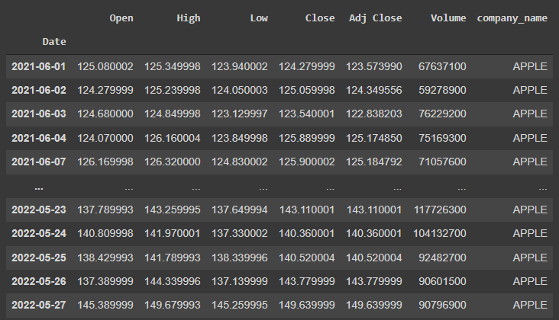
Online Stock Dataset - APPLE(AAPL)

Slide 6
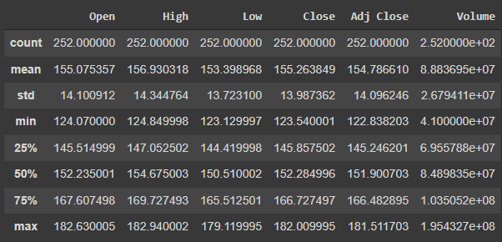
Summary statistics of attributes of Training Dataset

Slide 7
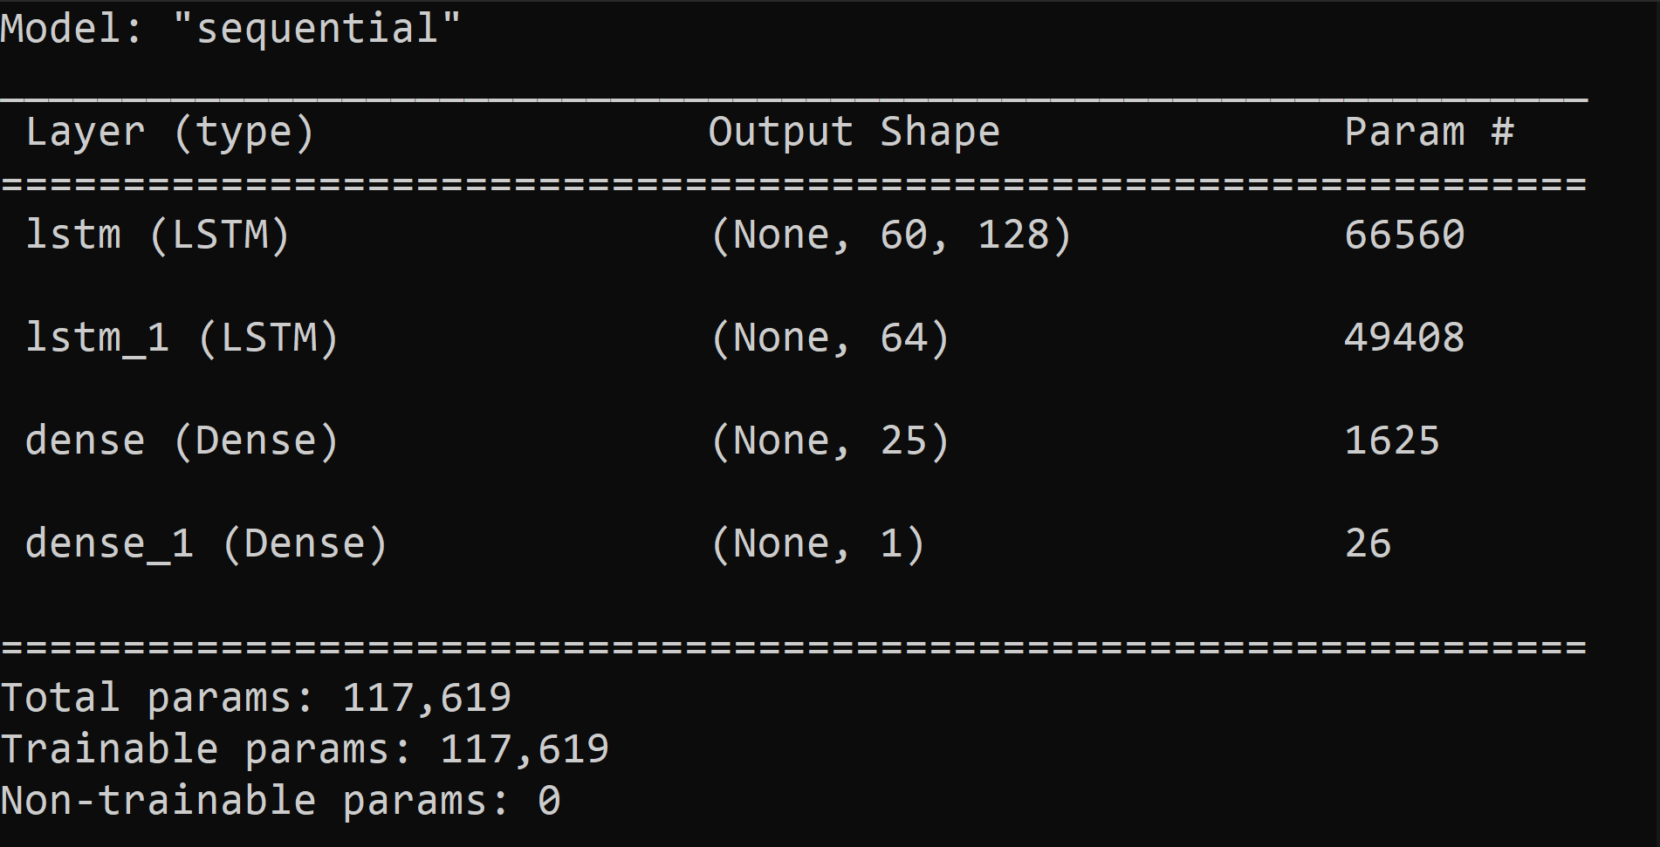
Summary statistics of LSTM Model

Slide 8
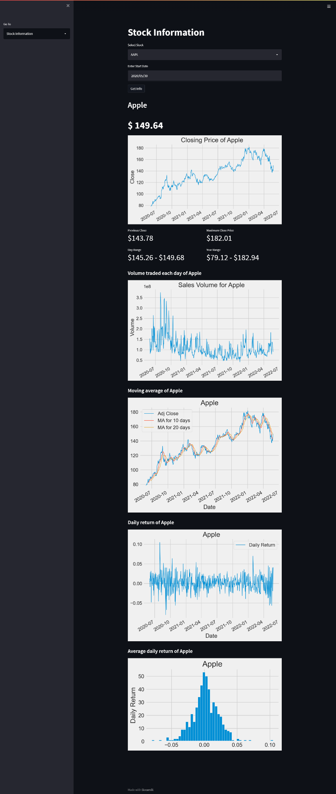
Stock Information Page

Slide 9
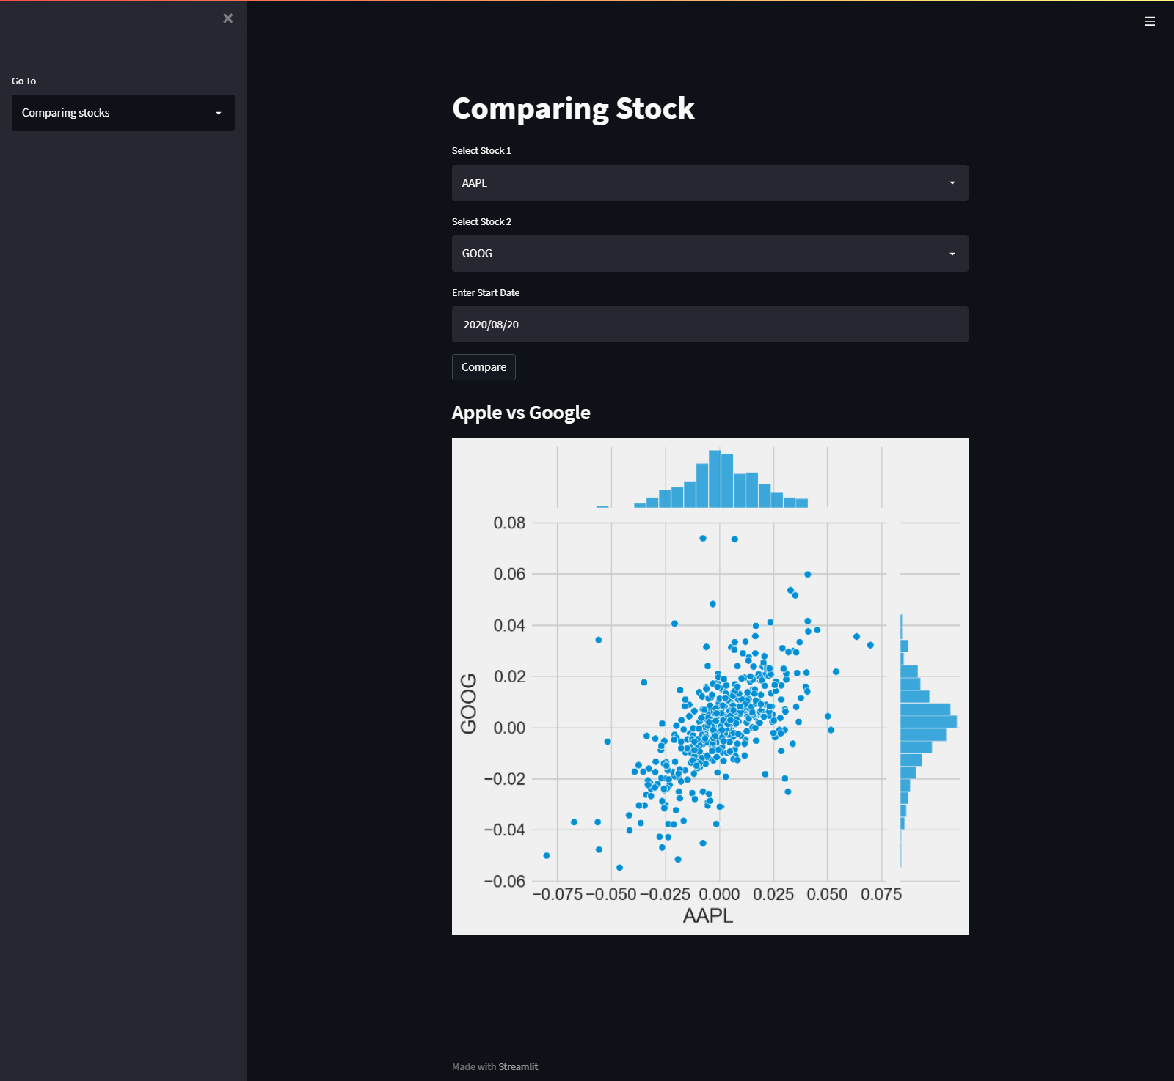
Stocks Comparing Page

Slide 10
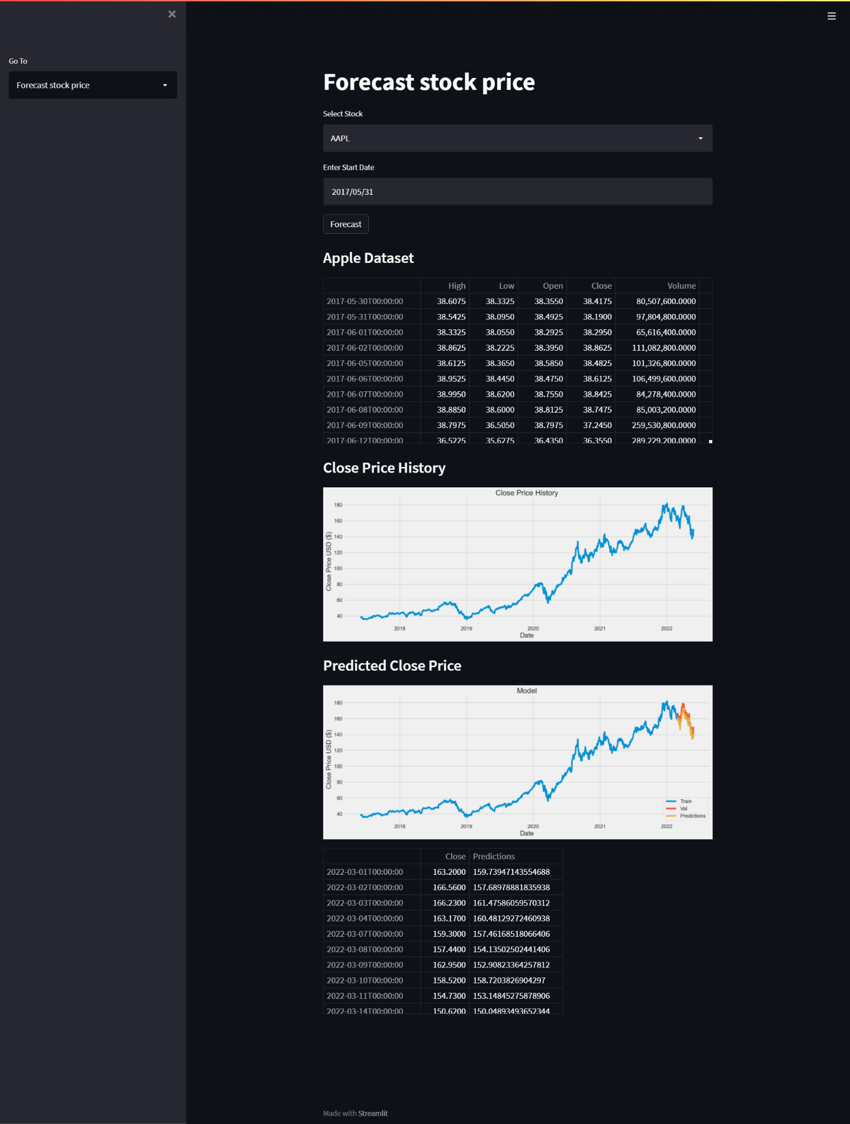
Forecast Stock Page

Slide 11
Testing

Slide 12
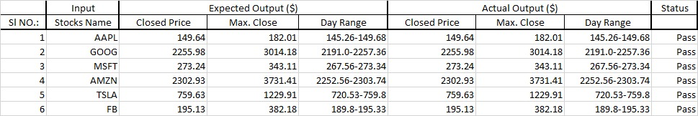
Stock Information Testing

Slide 13
Conclusion

Slide 14
Conclusion
We've discovered that machine learning can be used to anticipate and compare stock market prices. The result demonstrates how historical data may be used to anticipate stock movement with fair accuracy, but the technique chosen is dependent on the factors required, such as time, variance, and mean accuracy. The LSTM is a superior choice if high accuracy and low variation are required, but it is also slower. Backpropagation is preferable if high speed and accuracy are required. We've included seven criteria (Date, Open, Close, High, Low, Adj Close, Volume) that influence stock performance in this implementation. A better degree of accuracy can be attained if a larger number of factors are employed, and the data is preprocessed and filtered properly before being used to train the network model.

Slide 15
THANK YOU

